Slide 1



Python 3 Beginner
Chapter 00
Previously, on Python 3 Beginner…
release 1.0.0
37/39 Avenue Ledru Rollin – CS 11237 – 75750 PARIS CEDEX 12 - info@valnaos.com – www.valnaos.com Tél : 01 86 95 20 48

Slide 2

What we saw last time
Python 3 Beginner
We went on a tour of the Python Standard Library and learned how to:
Perform operations on the filesystem and paths
Read from and write to files
Handle base64-encoded data
Serialize/deserialize python objects to pickle and JSON
Use math functions and random number generators
Handle date and time data with ease in Python
And more...

Slide 3

Cloud Technology Associate
Copyright © 2018 | 9
Q&A
37/39 Avenue Ledru Rollin – CS 11237 – 75750 PARIS CEDEX 12 - info@valnaos.com – www.valnaos.com Tél : 01 86 95 20 48

Slide 4

Where? Who?
Python 3 Beginner
Class Material
GitHub: https://github.com/cstar-industries/python-3-beginner
Instructor
Charles Francoise <charles@cstar.io>

Slide 5

Session Objectives
Python 3 Beginner
At the end of this session, you will be able to:
Define your own types in Python with a class
Add variables and methods to your custom types
Create instances of your classes
Use classes as a better replacement to other data types (like dicts)
Understand and make use of inheritance to better re-use existing code
Use type annotations and docstrings to make your code readable by anyone

Slide 6
Session Syllabus
Python 3 Beginner
Chapter | Subject | Start | End | Total Time (in hours)
00 | Previously on Python 3 Beginner… | 14:00 | 14:15 | 00:15
01 | Functions: Part I | 14:15 | 15:00 | 00:45
 | Coffee Break | 15:00 | 15:10 | 00:10
02 | Functions: Part II | 15:10 | 15:55 | 00:45
 | Coffee Break | 15:55 | 16:05 | 00:10
03 | Generators and Error Handling | 16:05 | 16:50 | 00:45
 | Coffee Break | 16:50 | 17:00 | 00:10
 | Workshop | 17:00 | 18:00 | 01:00
 | Total |  |  | 04:00

Slide 7
Python 3 Beginner
Chapter 01
Classes in Python
release 1.0.0
37/39 Avenue Ledru Rollin – CS 11237 – 75750 PARIS CEDEX 12 - info@valnaos.com – www.valnaos.com Tél : 01 86 95 20 48

Slide 8
Types are classes
Python 3 Beginner
We've seen a number of types:
Some basic: int, float, bool...
Some more complex: list, dict, datetime...
To get the type of an object we use the type built-in function
type(3)
int
print(type(3))
<class 'int'>
What is this class ?

Slide 9
Types are classes
Python 3 Beginner
Classes have variables
print(datetime.resolution)
0:00:00.000001
Classes have functions
print(datetime.now)
<function datetime.now>
print(datetime.now())
2020-04-25 21:55:25.754109

Slide 10
Types are classes
Python 3 Beginner
The objects' methods are functions from the class
d = datetime.now()
print(datetime.timestamp(d))
print(d.timestamp())
1587893892.289229
1587893892.289229
s = 'hello'
print(str.upper(s))
print(s.upper())
HELLO
HELLO

Slide 11
Let’s write some code!
Python 3 Beginner
s = 'hello'
print(str.upper(s))
print(s.upper())
HELLO
HELLO

Slide 12
Classes are namespaces
Python 3 Beginner
To create a class, use the class keyword
A class definition block (indented) begins after the colon
As with functions, symbols defined inside the class are not visible outside the block
class A:
greeting = 'Hello'
counter = 0
print(A)
print(type(A))
print(A.greeting)
<class '__main__.A'>
<class 'type'>
Hello

Slide 13
Classes are namespaces
Python 3 Beginner
Classes "contain" variables
print(A.counter)
A.counter += 1
print(A.counter)
0
1
Classes "contain" functions
class A:
def say_hello():
print("Hello World!")
A.say_hello()
Hello World!

Slide 14
Classes are namespaces
Python 3 Beginner
class A
greeting
say_hello
'Hello World!
print('Hello World!')
counter
0

Slide 15
Let’s write some code!
Python 3 Beginner
class A:
def say_hello():
print('Hello World!')
A.say_hello()

Slide 16
Classes are types
Python 3 Beginner
You can create an object using your class using a function-like notation
a = A()
type(a)
__main__.A
The class is the object's type
type(a) == A
True
An object of type A is also called an instance of class A.

Slide 17
Classes are types
Python 3 Beginner
What happens when we use a function as a method?
a.say_hello()
TypeError: say_hello() takes 0 positional arguments but 1 was given
Remember how we used the function from the class
s = 'hello'
print(str.upper(s))
print(s.upper())
HELLO
HELLO

Slide 18
Classes are types
Python 3 Beginner
Let's define a new class B with a function taking a single argument: self
class B:
def say_hello(self):
print('Hello World!')
b = B()
b.say_hello()
Hello World!
The function can still be used from the class
B.say_hello(b)
Hello World!

Slide 19
Classes are types
Python 3 Beginner
Using a method with the instance.methodname notation is equivalent to passing the instance as first argument to the function
By convention, this first argument is always named self
Similar to this in C++ and Java, but explicitly bound as an argument

Slide 20
Classes are types
Python 3 Beginner
Class attributes are available in instances
class C:
greeting = 'Hello!'
print(C.greeting)
c = C()
print(c.greeting)
Hello!
Hello!

Slide 21
Let’s write some code!
Python 3 Beginner
class B:
def print_self(obj):
print(obj)
b = B()
print(b)
b.print_self()
<__main__.B object at 0x7ff4d0f840f0>
<__main__.B object at 0x7ff4d0f840f0>

Slide 22
Chapter Summary
Python 3 Beginner
In this chapter, we learned how to:
Define our own classes
Use them as types and create new instances
Define variables and functions inside a class
Call functions as methods of instances
Understand the use of self in methods

Slide 23
Python 3 Beginner
Chapter 02
Object-Oriented Programming
release 1.0.0
37/39 Avenue Ledru Rollin – CS 11237 – 75750 PARIS CEDEX 12 - info@valnaos.com – www.valnaos.com Tél : 01 86 95 20 48

Slide 24
More on methods
Python 3 Beginner
Methods can have more than one argument
class A:
def add_two(self, num):
return num + 2
a = A()
print(a.add_two(8))
10
First argument – self – always set to instance

Slide 25
Initializer special function
Python 3 Beginner
The special method __init__ is called when you create a new instance
Arguments given to the creation call are passed on to __init__
Use the __init__ function to create and initialize instance attributes
class A:
def __init__(self, id):
self.created_at = datetime.now()
self.id = id
a = A(303)
print(a.created_at)
print(a.id)
2020-04-26 15:21:01.374870
303

Slide 26
Instance variables
Python 3 Beginner
Instance variables are unique to each instance
a = A(303)
# Time passes...
b = A(123)
print(f'a({a.id}) – {a.created_at}')
print(f'b({b.id}) – {b.created_at}')
a(303) – 2020-04-26 15:21:01.374870
b(123) – 2020-04-26 16:20:11.459183

Slide 27
Instance variables
Python 3 Beginner
Use methods to change instance attributes
class Adder:
def __init__(self):
self.add_counter = 0
def add(self, a, b):
self.add_counter += 1
return a + b
a1 = Adder()
a2 = Adder()
print(a1.add(2, 3), a1.add(3, 7))
print(a1.add_counter)
print(a2.add_counter)
5 10
2
0

Slide 28
(Return to) Conceptual view of a function
Python 3 Beginner
Old state
.
.
.
arguments
.
.
.
function
Do something using the arguments
return
New state

Slide 29
Conceptual view of an object
Python 3 Beginner
Object
Old state
(attributes)
.
.
.
arguments
.
.
.
method
Do something using the arguments
return
New state
(modified attributes)

Slide 30
Conceptual view of an object
Python 3 Beginner
An object is a mechanism to bundle state (attributes) with behavior (methods).

Slide 31
Objects as higher level structured data
Python 3 Beginner
Before classes we used dicts
guido = {'first_name': 'Guido', 'last_name': 'van Rossum', 'email': 'guido@python.org'}
def format_contact(c):
return f'{c['first_name']} {c['last_name']} <{c['email']}>'
print(format_contact(guido))
Guido van Rossum <guido@python.org>
Let's do this with classes

Slide 32
Objects as higher level structured data
Python 3 Beginner
Write initializer
Use attributes instead of dict keys
Write functions as methods
class Contact:
def __init__(self, first_name, last_name, email):
self.first_name = first_name
self.last_name = last_name
self.email = email
def format(self):
return f'{self.first_name} {self.last_name} <{self.email}>'
guido = Contact('Guido', 'van Rossum', 'guido@python.org')
print(guido.format())
Guido van Rossum <guido@python.org>

Slide 33
Let’s write some code!
Python 3 Beginner
def f():
a = []
print(a)
a += [0, 1, 2]
print(a)
f()
print(a)
[]
[0, 1, 2]
NameError: name 'a' is not defined

Slide 34
Class attributes vs. Instance attributes
Python 3 Beginner
Class attributes are shared by all instances
class A:
items = []
def add_item(self, item):
self.items.append(item)
a = A()
b = A()
a.add_item('hello')
b.add_item('world')
print(a.items)
['hello', 'world']

Slide 35
Class attributes vs. Instance attributes
Python 3 Beginner
Instance attributes are unique to each instance
class A:
def __init__(self):
self.items = []
def add_item(self, item):
self.items.append(item)
a = A()
b = A()
a.add_item('hello')
b.add_item('world')
print(a.items)
['hello']

Slide 36
Class attributes vs. Instance attributes
Python 3 Beginner
Class methods apply to the class object (not the instance)
class A:
number_of_instances = 0
def __init__(self):
self.add_instance()
@classmethod
def add_instance(cls):
cls.number_of_instances += 1
a = A()
b = A()
print(A.number_of_instances)
2

Slide 37
Class attributes vs. Instance attributes
Python 3 Beginner
Static methods apply to no object (regular function)
class A:
def __init__(self):
self.add_instance()
@staticmethod
def greet(greetee):
print(f'Hello {greetee}!')
A.greet('World')
Hello World!

Slide 38
Let’s write some code!
Python 3 Beginner
red_team = Team('Red Team')
red_team.add_person('Jack')
red_team.add_person('John')
red_team.add_person('Bart')
print(f'{red_team.name}: {red_team.people}')
Red Team: ['Jack', 'John', 'Bart']

Slide 39
Chapter Summary
Python 3 Beginner
In this chapter, we learned about:
Initializing a class with the special __init__ method
Instance variables and Class variables
The fundamental concept behind OOP
Solving problems with classes

Slide 40
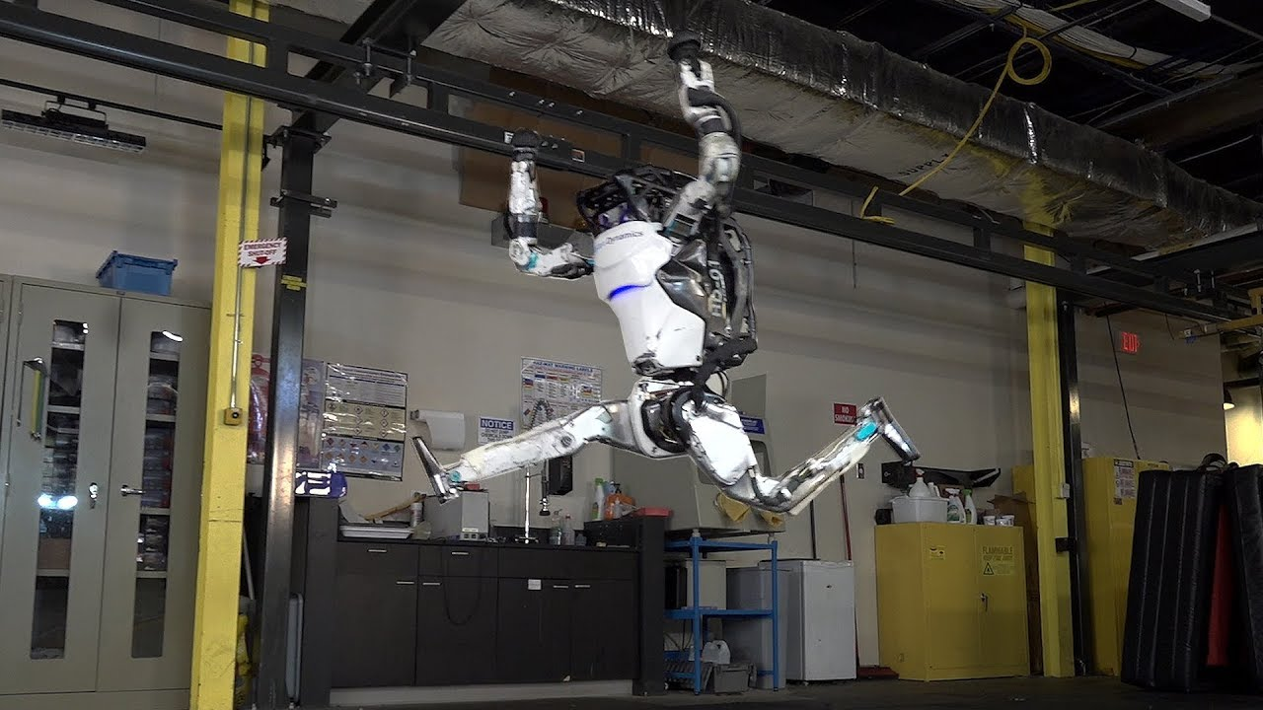
Workout Time!
Python 3 Beginner
Notes:
https://github.com/cstar-industries/python-3-beginner/blob/master/001-First-Steps/First%20Steps%20-%20Chap%2002%20-%20Exercises.ipynb

Slide 41
Python 3 Beginner
Chapter 03
Inheritance and Python specifics
release 1.0.0
37/39 Avenue Ledru Rollin – CS 11237 – 75750 PARIS CEDEX 12 - info@valnaos.com – www.valnaos.com Tél : 01 86 95 20 48

Slide 42
Inheritance
Python 3 Beginner
Sometimes, classes can share a lot of behavior with others
class Album:
def __init__(self, title, artist, songs):
self.title = title
self.artist = artist
self.songs = songs
def play(self):
print(f'Playing "{self.songs[0]}"...')
class Playlist:
def __init__(self, title):
self.title = title
self.songs = []
def add_song(self, song):
self.songs.append(song)
def play(self):
print(f'Playing "{self.songs[0]}"...')

Slide 43
Inheritance
Python 3 Beginner
Create a class with all common code: the superclass
class Collection:
def __init__(self, title):
self.title = title
self.songs = []
def play(self):
print(f'Playing "{self.songs[0]}"...')

Slide 44
Inheritance
Python 3 Beginner
Create specialized classes (subclasses) without repeating code
class Album(Collection):
def __init__(self, title, artist, songs):
super().__init__(title)
self.artist = artist
self.songs = songs
class Playlist(Collection):
def add_song(self, song):
self.songs.append(song)
Call methods from the superclass on the subclass
album = Album('2001', 'Dr. Dre', [...])
album.play()
Playing "Lolo(Intro)"...

Slide 45
Let’s write some code!
Python 3 Beginner
c = C('Instance of C', hello='world', count=1)
print(c.data)
Initializing C: Instance of C
Initializing B: Instance of C
Initializing A: Instance of C
{'hello': 'world', 'count': 1}

Slide 46
Annotations
Python 3 Beginner
Use docstrings to document your code (classes, attributes and methods)
class Accumulator:
"""Accumulates count by adding values. Initialized at 0"""
def __init__(self):
self.acc = 0
def add(self, increment):
"""Increase the count by increment"""
self.acc += increment
help(Accumulator)
class Accumulator(builtins.object)
| Accumulates count by adding values. Initialized at 0
|
| Methods defined here:
|
| add(self, increment)
| Increase the count by increment

Slide 47
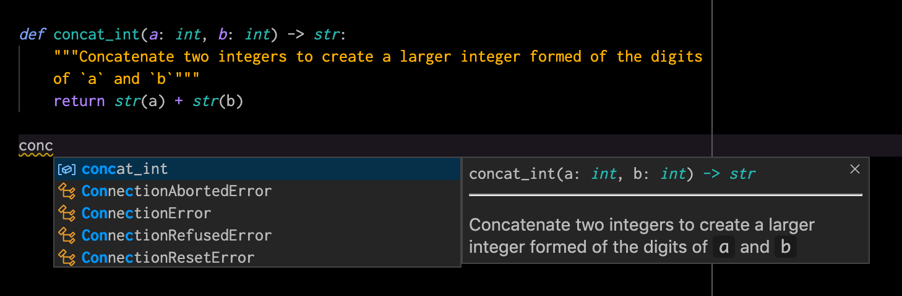
Annotations
Python 3 Beginner
Type annotations will be used by code editors and linters to help avoid bugs in your code

Slide 48
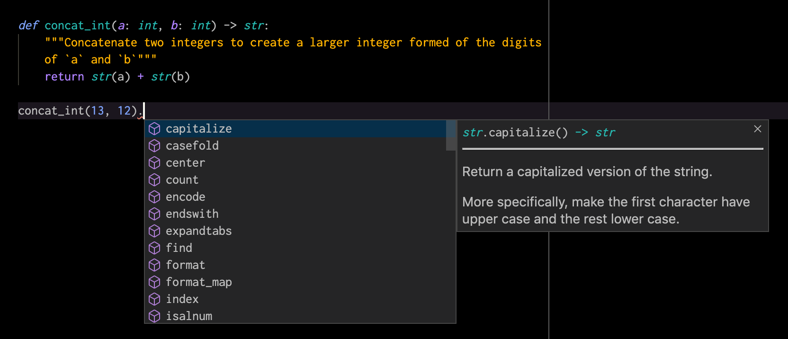
Annotations
Python 3 Beginner
Type annotations will be used by code editors and linters to help avoid bugs in your code

Slide 49
Special methods
Python 3 Beginner
There are other special methods besides __init_ to interact more idiomatically with the Python language
class Accumulator:
def __init__(self):
self.acc = 0
def add(self, increment):
self.acc += increment
a = Accumulator()
b = Accumulator()
print(a == b)
False

Slide 50
Special methods
Python 3 Beginner
Redefine equality with __eq__
class Accumulator:
...
def __eq__(self, other):
return self.acc == other.acc
a = Accumulator()
b = Accumulator()
print(a == b)
a.increment(1)
print(a == b)
True
False

Slide 51
Special methods
Python 3 Beginner
Provide relevant stringification with __str__ and __repr__
class Accumulator:
...
def __repr__(self):
return f'Accumulator({self.acc})'
def __str__(self):
return str(self.acc)
a = Accumulator()
a.add(1138)
print(a)
a
1138
Accumulator(1138)

Slide 52
Special methods
Python 3 Beginner
Any other operator can be redefined:
< : __lt__, > : __gt__, != : __ne__...
Indexing with [] can be defined in your classes: __getitem__, __setitem__...
Type conversion with: __str__, __int__, __bytes__...
Even iteration with for can work in your classes with: __iter__ and __next__
⚠️ This power should not be abused. Only use this when you are sure it is useful, and the usage is unambiguous to anyone else. Remember: Clear is better than clever.
To learn more, read the documentation.

Slide 53
Let’s write some code!
Python 3 Beginner
class Accumulator:
"""Accumulates count by adding values. Initialized at 0"""
def __init__(self):
self.acc = 0
def add(self, increment: int):
"""Increase the count by increment"""
self.acc += increment
def __eq__(self, other):
return self.acc == other.acc
def __repr__(self):
return f'Accumulator({self.acc})'
def __str__(self):
return str(self.acc)

Slide 54
Chapter Summary
Python 3 Beginner
In this chapter, we learned:
The object-oriented concept of inheritance and how to implement it in Python
How to document code effectively with docstrings
How to use type annotations to document functions and facilitate code readability
The special methods used to make our classes play better with Python

Slide 55
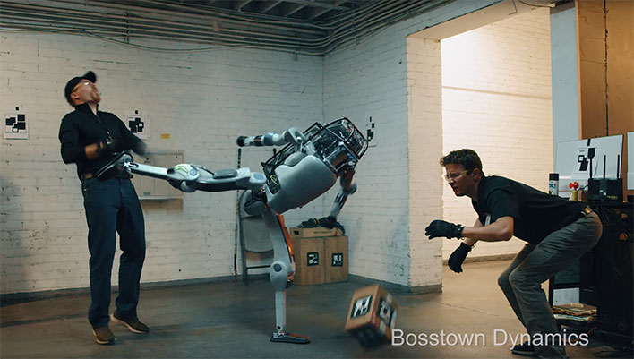
Workout Time!
Python 3 Beginner
Notes:
https://github.com/cstar-industries/python-3-beginner/blob/master/001-First-Steps/First%20Steps%20-%20Chap%2003%20-%20Exercises.ipynb

Slide 56
Cloud Technology Associate
Copyright © 2018 | 9
Q&A
37/39 Avenue Ledru Rollin – CS 11237 – 75750 PARIS CEDEX 12 - info@valnaos.com – www.valnaos.com Tél : 01 86 95 20 48

Slide 57
Workshop
Python 3 Beginner
Notes:
https://github.com/cstar-industries/python-3-beginner/blob/master/001-First-Steps/First%20Steps%20-%20Workshop.ipynb

Slide 58
Thank you for your attention!

